Slide 1
AMSA’s Under Keel Clearance Management (UKCM) System for Torres Strait
^{AMPTC 78} ^{(21 Feb 2017)}
Conrad Adams
Principal Advisor – Coastal Pilotage
Australian Maritime Safety Authority (AMSA)

Slide 2
Presentation Overview
Where is the Torres Strait UKCM area?
Why a UKCM System?
Implementation & UKCM Framework
System overview (screen shots and sensors)
Chart overlays / graphic enhancements
Notes:
Presentation outline/scope

Slide 3
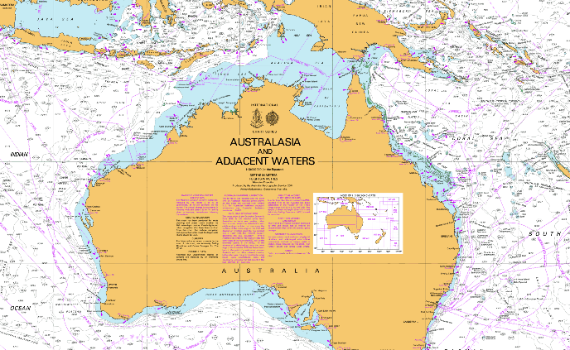
Where is Torres Strait?
Torres Strait lies between Papua New Guinea and the northern tip of the Australian continent.
Torres Strait is a vital shipping route for the Asia-Pacific region.

Slide 4
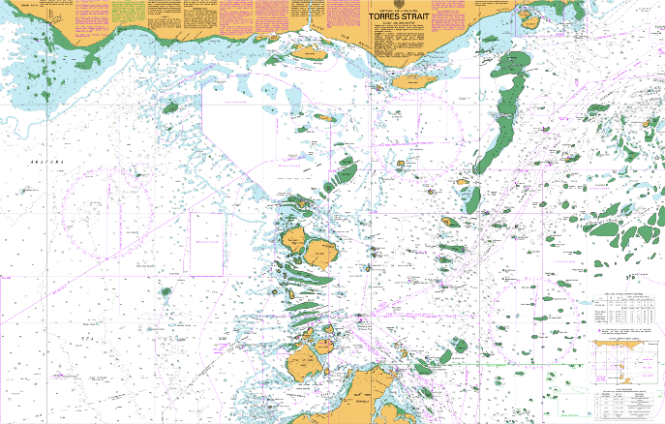
UKCM System - Monitoring Area
PNG
Cape York
UKCM Monitoring Area

Slide 5
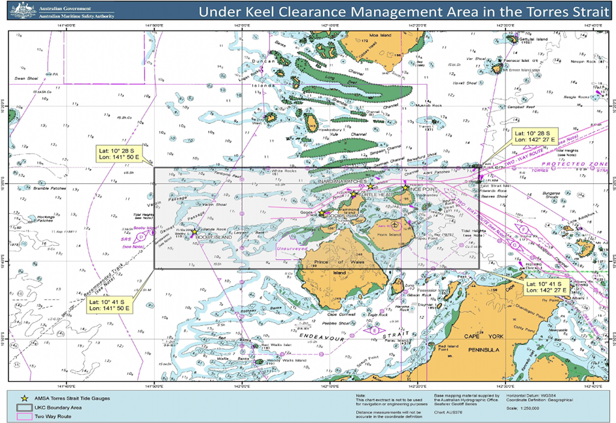
Monitoring Area Approaches
The UKCM System monitoring area can be approached from:
the west (via Booby Island)
the north-east (via Dalrymple Island -Great North East Channel - GNEC)
the south (via the Inner Route of the Great Barrier Reef)

Slide 6
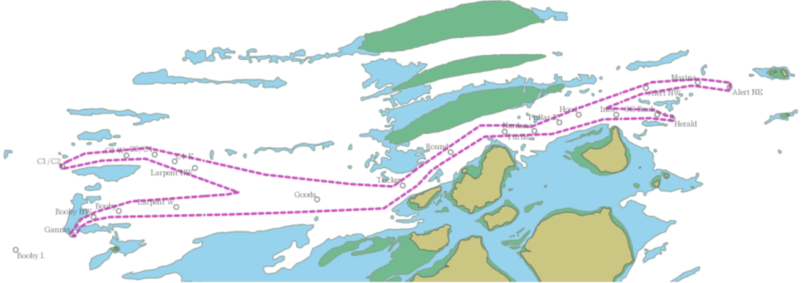
UKCM System - UKC Corridor
Marina Rock
Herald Patches
Channel
Varzin Passage
Prince of Wales
GannetPassage
(Magenta dotted line (----) indicates the UKCM system corridor)

Slide 7
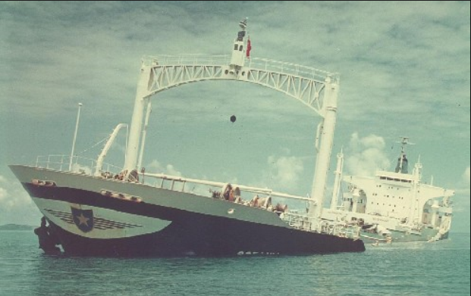
Why a UKCM System?
Torres Strait is a remote, environmentally sensitive area.
It was formally declared a ‘Particularly Sensitive Sea Area’ (PSSA) by the International Maritime Organisation (IMO) in 2005, via Resolution MEPC.133(53).
Oceanic Grandeur Grounding & Subsequent Oil Spill in Torres Strait – O.G Rock (March 1970)

Slide 8
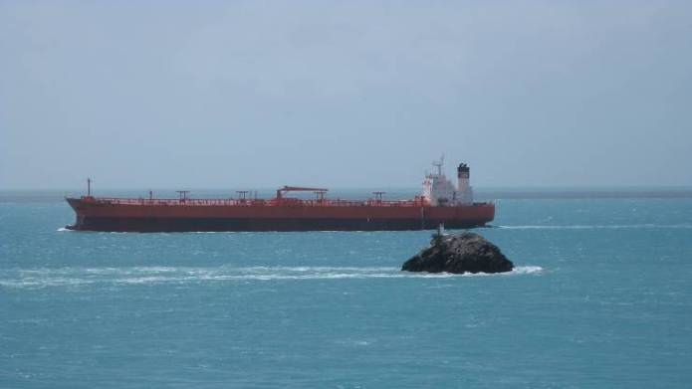
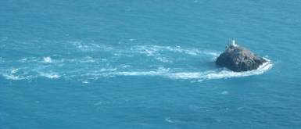
Why a UKCM System?
The numerous large ships that transit Torres Strait face many challenges to safe navigation due to the numerous reefs, shallow waters, complex tides & strong tidal streams.
A UKCM system is a contemporary Aid to Navigation (AtoN) which enhances navigational safety.

Slide 9
Why a UKCM System?
To deliver enhanced safety of navigation by:
establishing mandatory arrangements for the transits of vessels 8m draught or greater (since 1 July 2014 per MO54 (2014));
validating the existing safety margin prescribed by Australian Law (minimum UKC of 1.0 m or 10% of draught in POWC); and
evaluating the appropriateness of the current draught regime (maximum draught of 12.2 m).
AMSA’s UKCM system also provides a mechanism to considering adopting a dynamic UKC regime (i.e. requiring a minimum UKC without a draught restriction).

Slide 10
UKCM Framework
Information: Real-time met-ocean sensors and hydrographic data (including periodic re-surveys).
The UKCM System generates ‘transit windows’ to maintain the required UKC.
System: User-Web interface.
Users: Pilots, Pilotage Providers and Vessel Operators.
Regulation: Marine Order 54 (= Regulations = Australian Law).
Monitoring: Ongoing ‘validation’ of system performance.

Slide 11
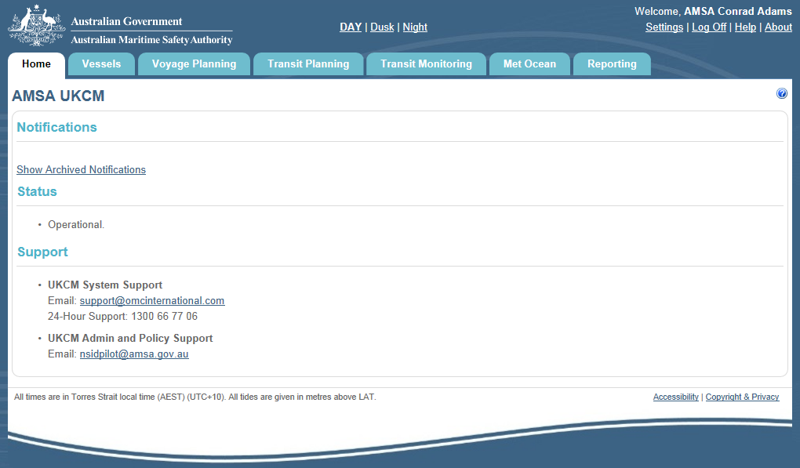
UKCM System - Home Tab
Notes:
Sample UKCM System – Home Page

Slide 12
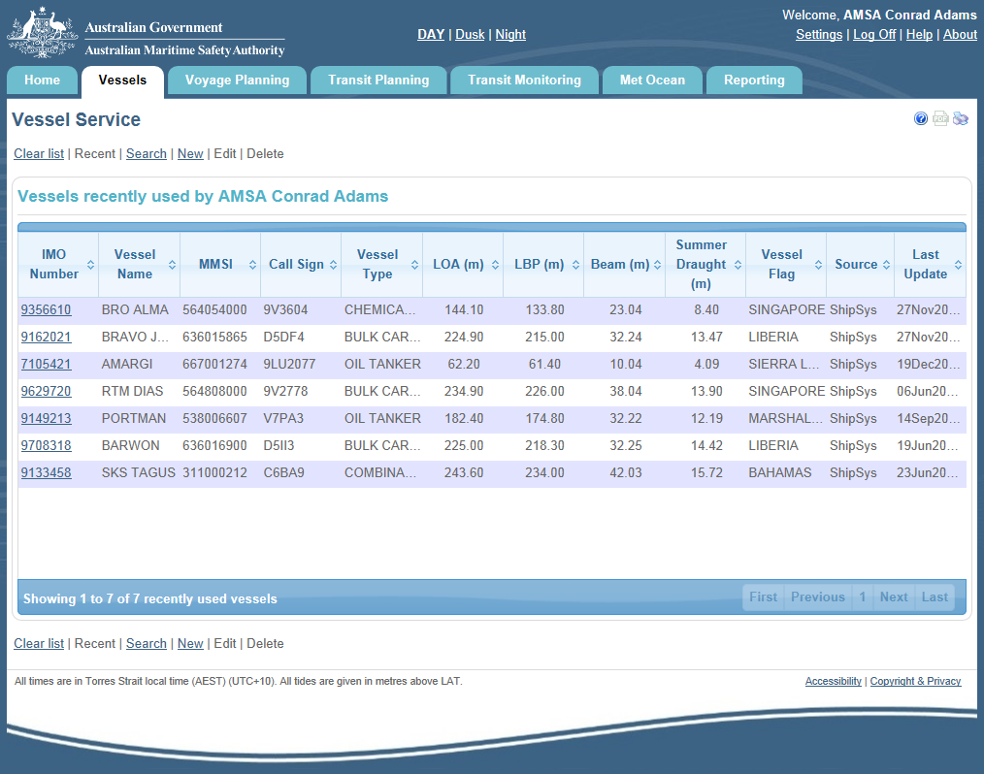
UKCM System – Vessels Tab
Notes:
Sample UKCM System – Vessel Service Page

Slide 13
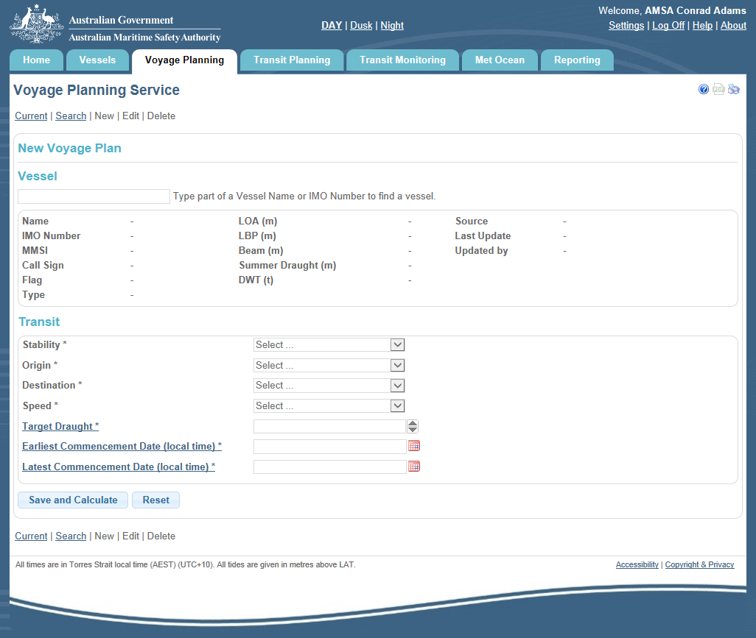
UKCM System - Voyage Planning
The Voyage Planning service provides long-term forecasting of potential tidal windows for vessel transits.
The system user selects a previous plan for a particular vessel (on which to base a new plan), or enters ship particulars for a new Voyage Plan including intended route (data is retained).

Slide 14
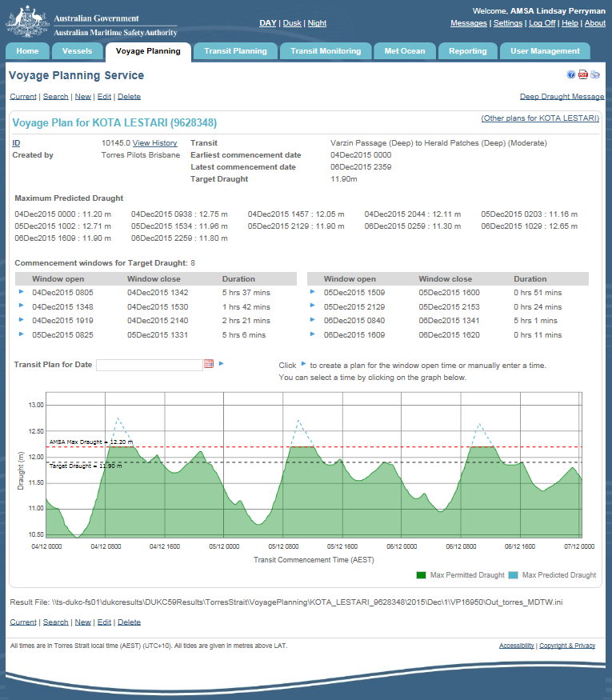
UKCM System – Voyage Planning
The Voyage Planning service generates max. draughts & tidal windows for any 7 day period, up to 1 year in advance.
Tidal windows are based on astronomical predictions provided by the Bureau of Meteorology.

Slide 15
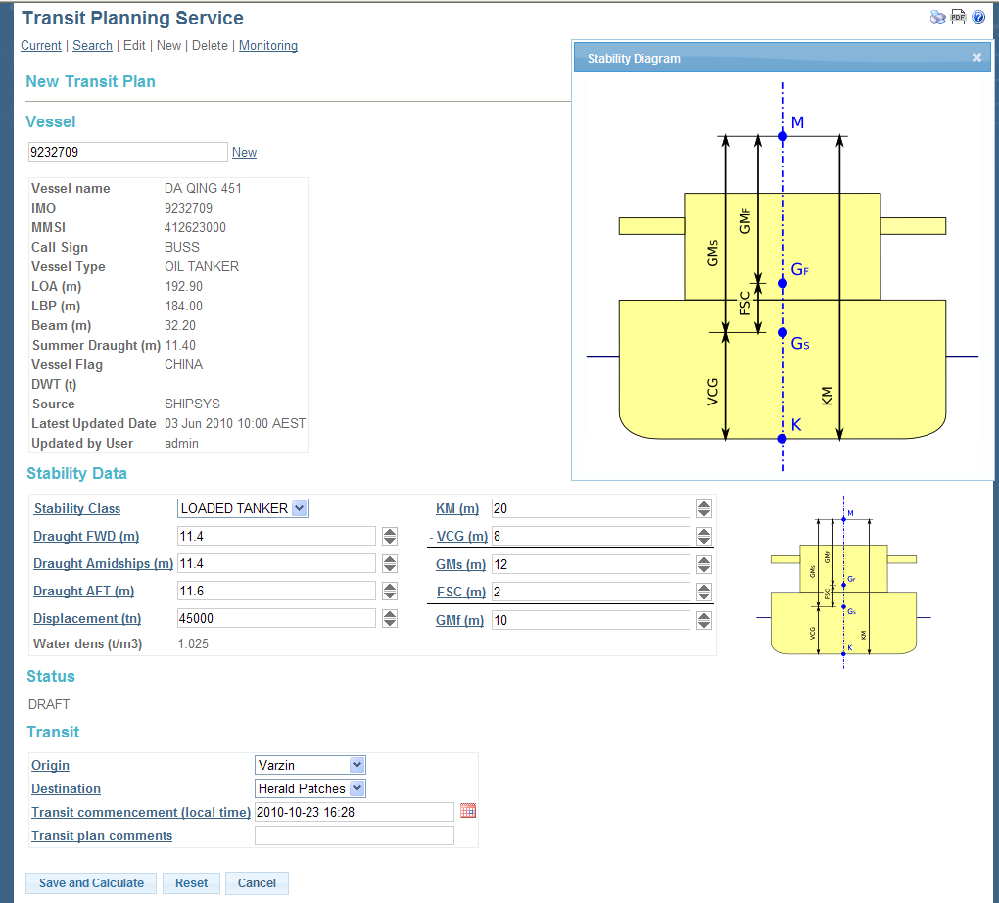
UKCM System – Transit Planning
Transit Planning Service
The system user selects an existing vessel, or a previous plan, or enters new ship particulars including stability data (data is retained).

Slide 16
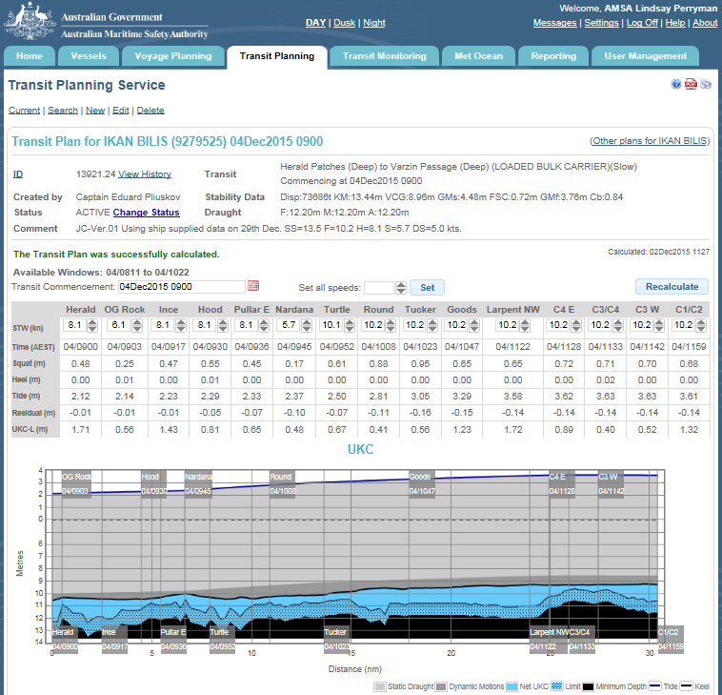
UKCM System – Transit Planning
The Transit Planning service provides short-term calculations (< 5 days) of tidal windows for vessel transits.
Tidal windows are based on forecast tidal predictions using the observed tides over the preceding one hour period to provide accurate forecasts.

Slide 17
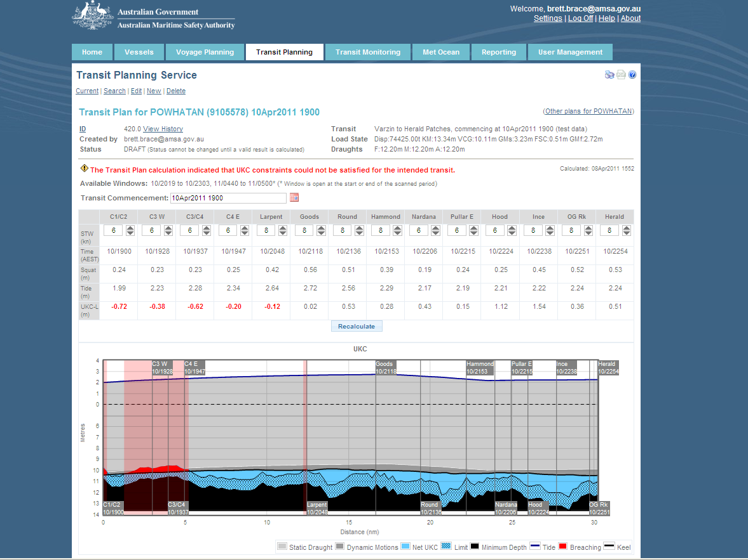
UKCM System – Transit Planning
The example shown here indicates that the UKC requirements for the intended transit could not be satisfied (indicated by the vertical red bars)
Changes to the planned speed, or commencement time, or both, are required to calculate a successful plan
Notes:
Sample UKCM System – Transit Planning Page - Breaching

Slide 18
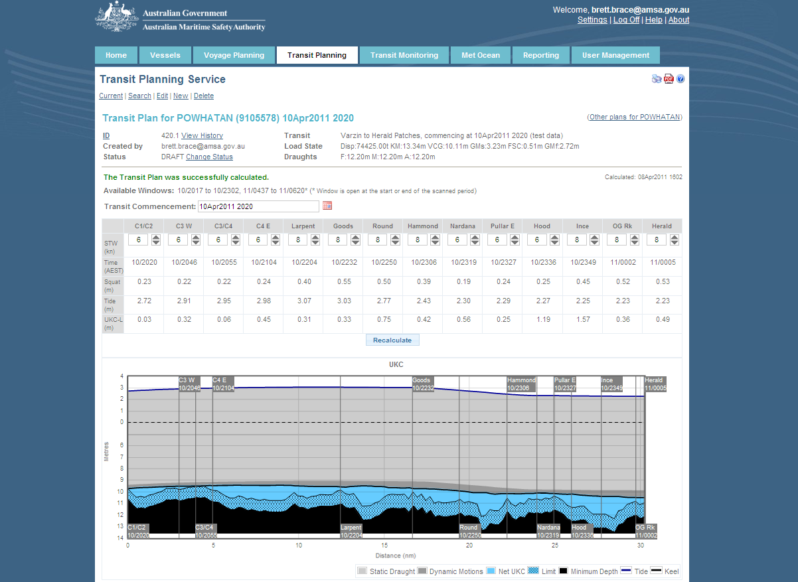
UKCM System – Transit Planning
After changing the commencement time for the previous plan, the example shown here indicates that the UKC requirements for the intended transit have been satisfied (i.e. no vertical red bars)
Notes:
Sample UKCM System – Transit Planning Page - Breaching

Slide 19
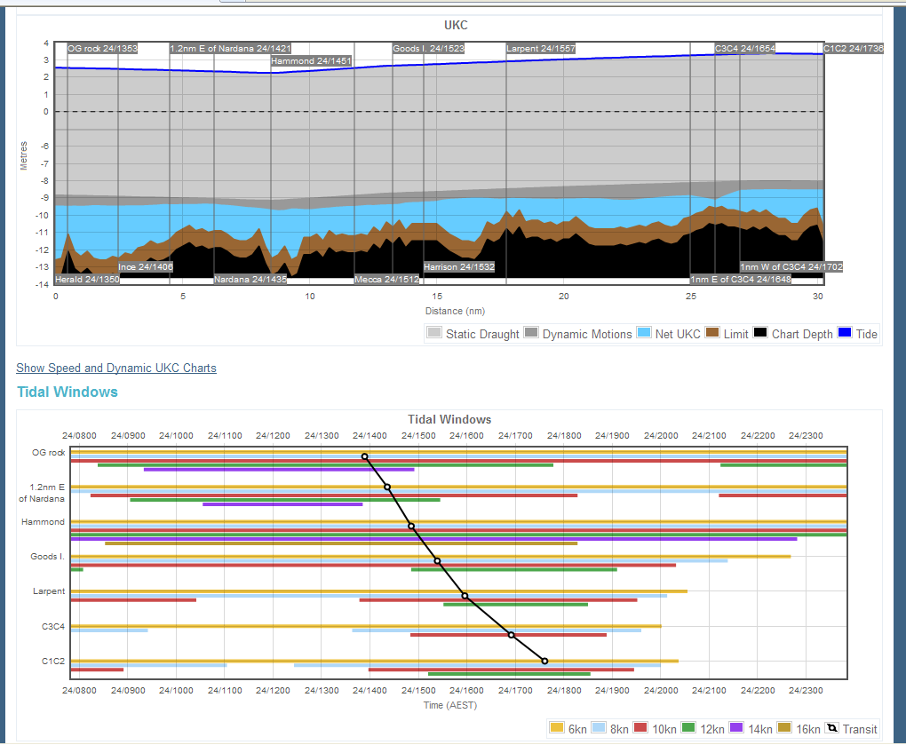
UKCM System – Transit Planning
Transit Planning Service
Graphical representation of tidal windows and planned speed across the key UKCM System waypoints

Slide 20
UKCM System – Transit Planning
Once made ‘ACTIVE’ the UKCM System continually updates forecast tides within the plan to provide a ‘real-time’ result.

Slide 21
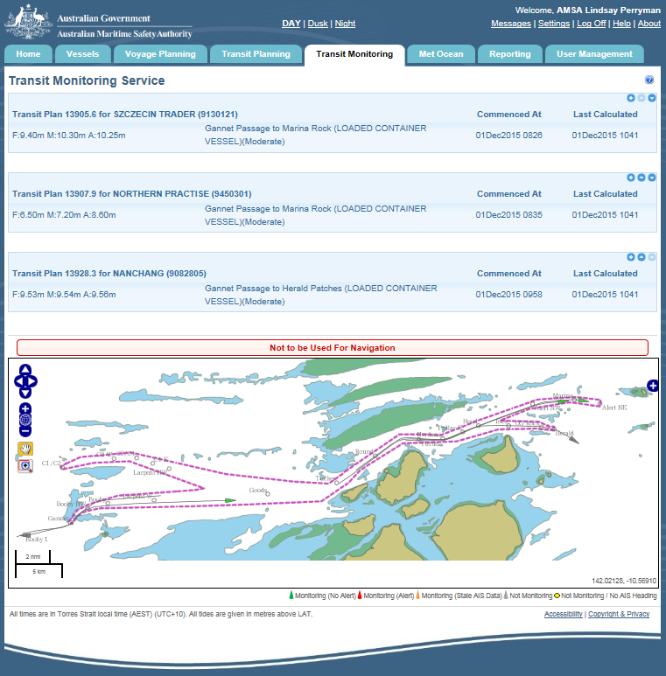
UKCM System - Transit Monitoring
The Transit Monitoring service provides a surface picture and real-time information about all vessels transiting the UKCM Monitoring Area.
All vessels with a functioning Class A AIS system will be displayed.
Vessels with Transit Plans will display individually above the monitoring area chartlet.

Slide 22
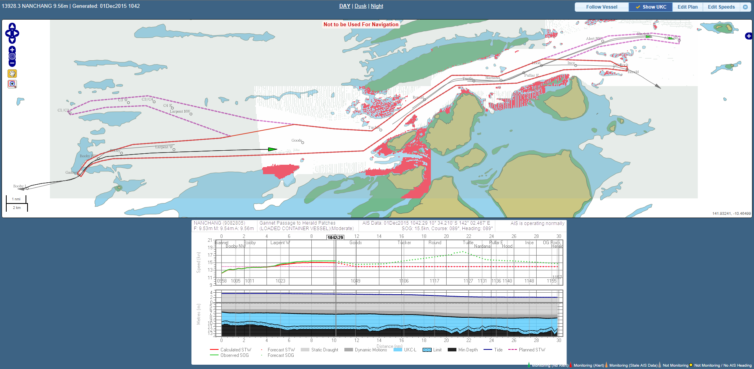
UKCM System - Transit Monitoring

Slide 23
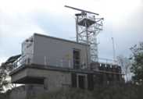
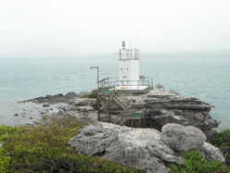
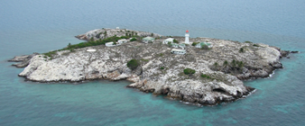
UKCMS AIS sensors
Hammond Hill (Radar and AIS Base Station)
Booby Island AIS (Base Station)
Albany Rock AIS (Base Station)
Notes:
The Torres Strait UKCMS relies on AIS from vessels transiting the area in order to make calculations. AIS Base Stations are located at Booby Island, Hammond Island (dual redundant set up), and Albany Rock. The nature of the AIS Base Station configurations is such that AIS reception in the Torres Strait UKCMS monitoring area can be achieved with one or more Base Stations off line.

Slide 24
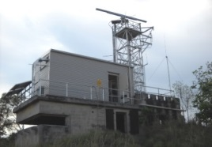
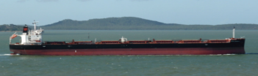
UKCM System Connectivity
Hammond Hill (Radar and AIS Base Station)
Not to be used for navigation
Radio Link to Horn Is.
Booby Island AIS (Base Station)
NextG
Internet
NextG Connection to Horn Is
Albany Rock AIS (Base Station)
Notes:
Vessels entering the UKCM monitoring area will be detected by one (or more) AIS base stations.
Data from the Booby Island and Albany Rock AIS base stations use a NextG connection to provide data to the internet (fed in at Horn Island). The Hammond Hill AIS base stations use a radio link to Horn Island as the primary communications pathway to the internet (with a NextG backup).
A submarine cable connects Horn Island with the Australian mainland. The telecommunications infrastructure used in Torres Strait is Telstra’s.

Slide 25
Met-Ocean Sensors & Real-Time Info
Real-time meteorological and oceanographic information is collected and input into the UKCM System using a variety of sensors located throughout Torres Strait including:
five (5) tide gauges
one (1) current meter
one (1) weather station and
two (2) directional wave-rider buoys.
These sensors capture the following data:
- Tide height observations (via tide gauges)
- Strength and direction of current (via current meter)
- Wind strength and direction (via weather station)
- Barometric pressure (via weather station)
- Humidity (via weather station)
- Sea surface temperature (via weather station)
- Precipitation (via weather station)
- Direction, period and height of waves (via wave-rider buoys).
Notes:
The aim of this slide is to highlight to the Board that AMSA has completed a significant upgrade to the Torres Strait Met-Ocean sensors as a critical component of the UKCM framework.

Slide 26
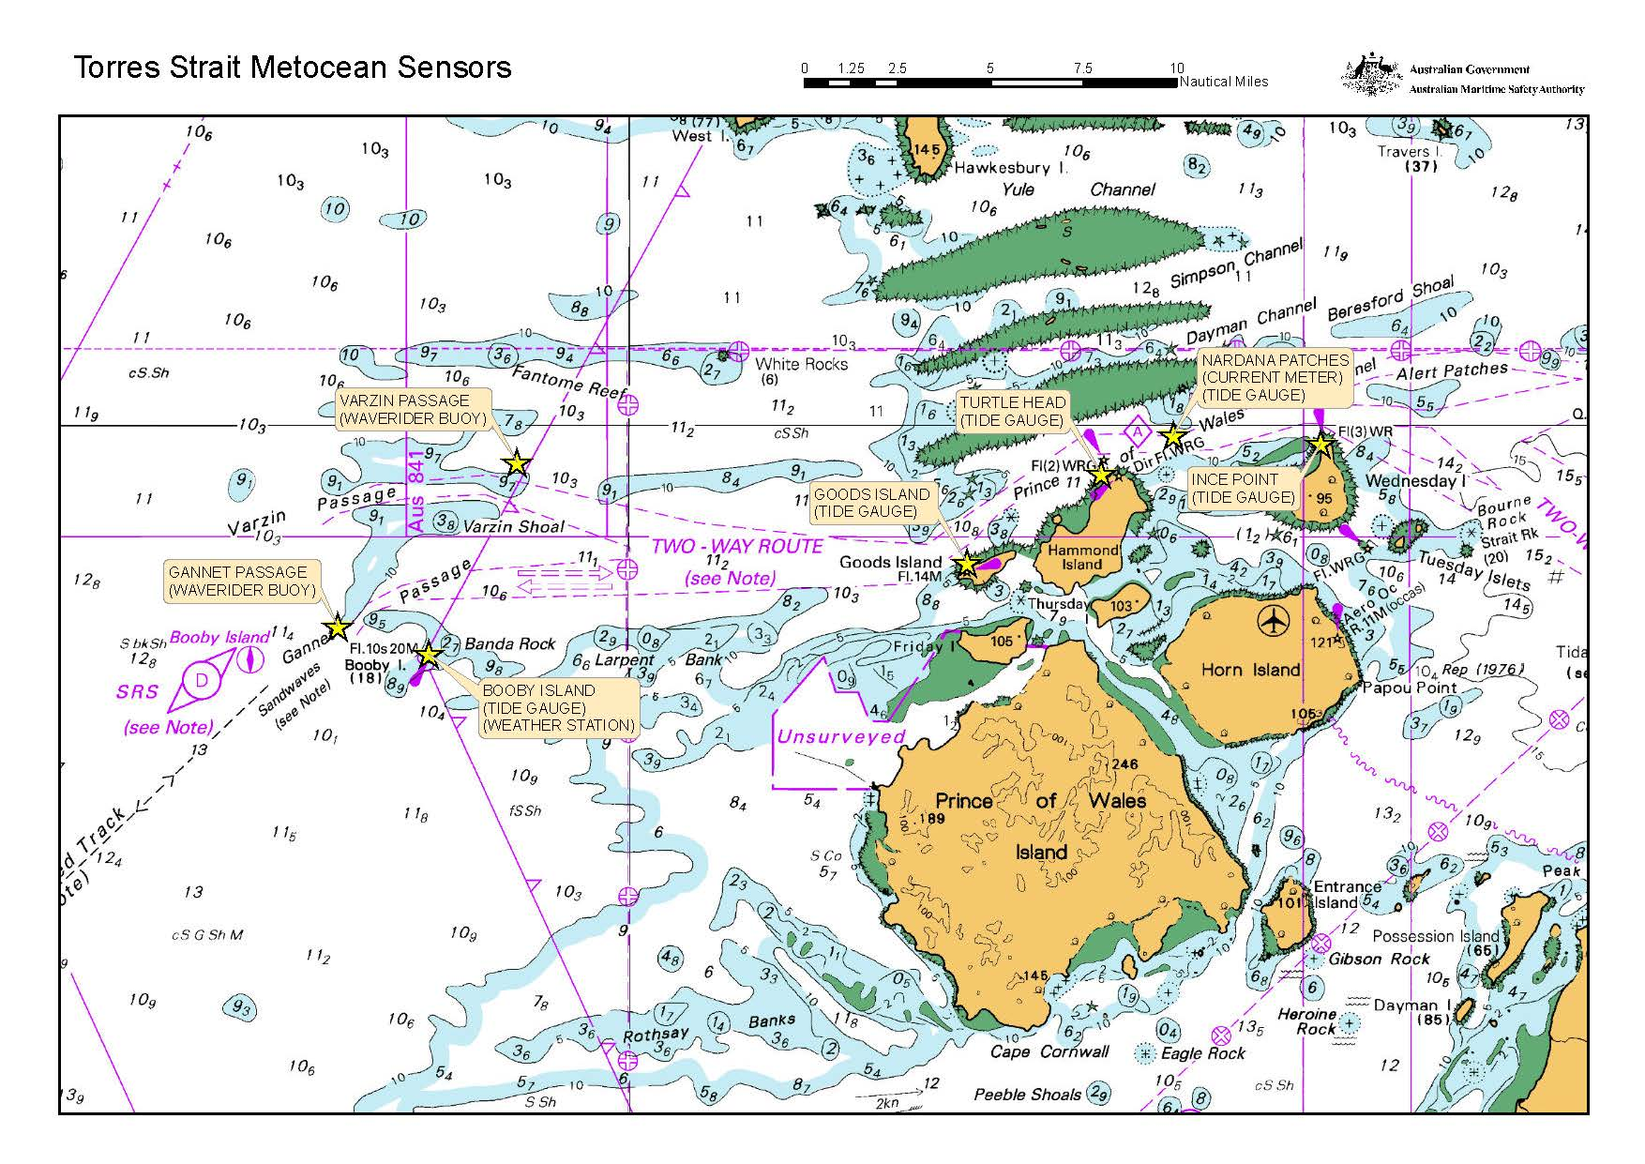
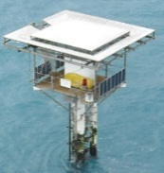
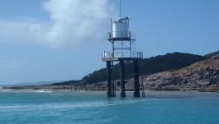
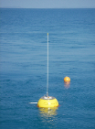
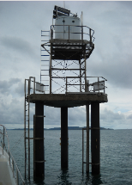
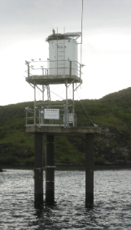

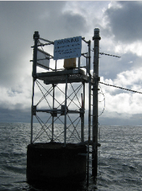
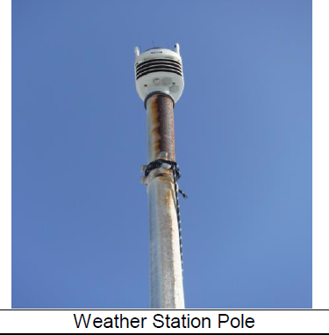
Map of Met-Ocean Sensors
Notes:
The aim of this slide is to highlight to the Board that AMSA has completed a significant upgrade to the Torres Strait Met-Ocean sensors as a critical component of the UKCM framework.

Slide 27
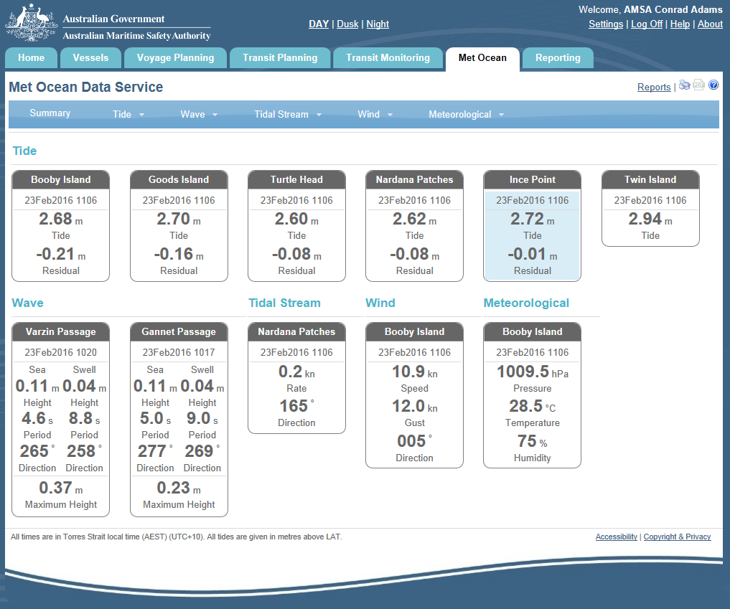
Met-Ocean Service
The Met-Ocean Service provides ‘real-time’ data received from all UKCM System sensors.
Information can be displayed summarily, or graphically for each sensor.
Notes:
Sample UKCM System – Met-Ocean Page

Slide 28
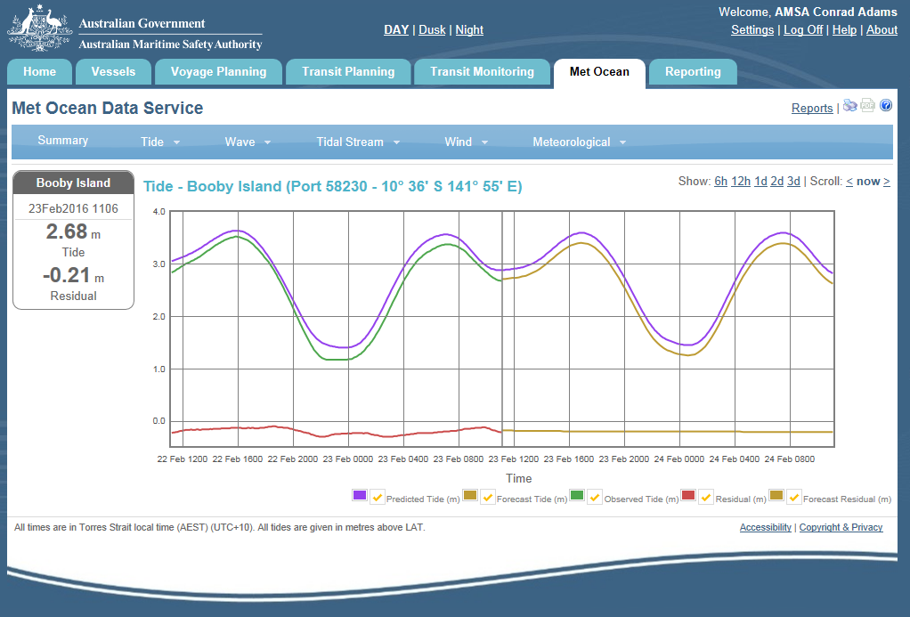
Met Ocean Data – Tide Detail

Slide 29
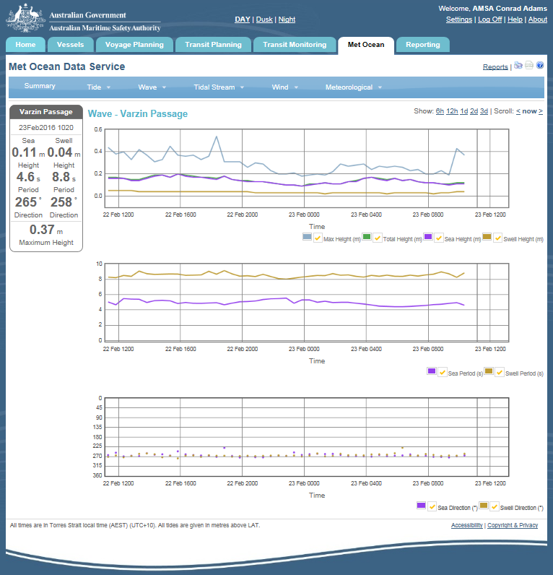
Met Ocean Data – Wave Detail

Slide 30
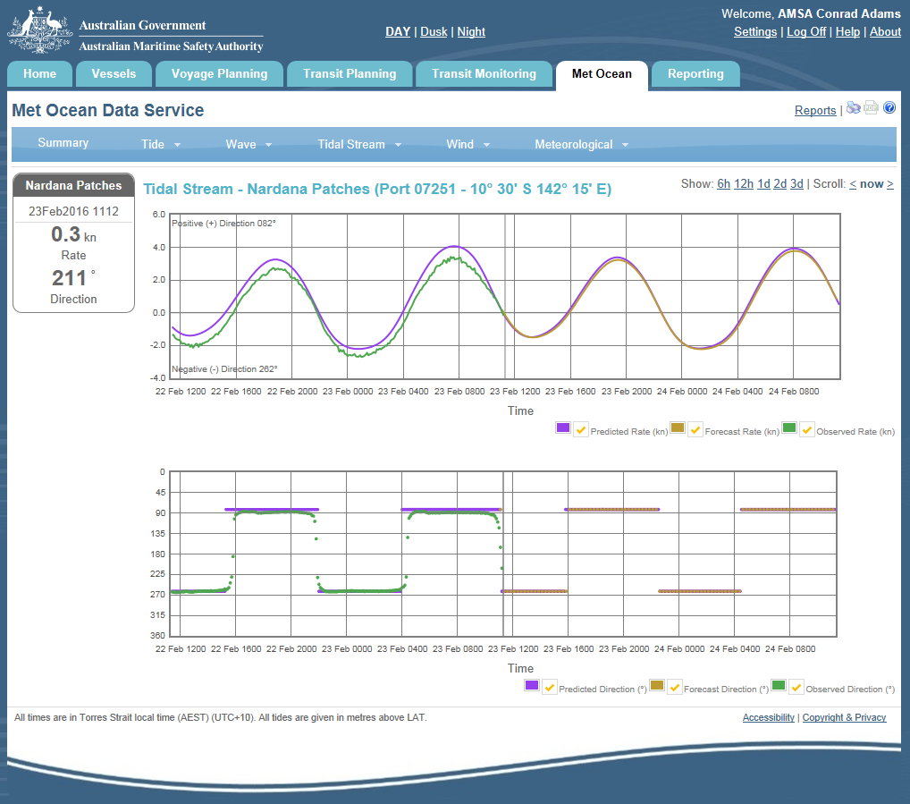
Met Ocean Data – Tidal Stream Detail

Slide 31
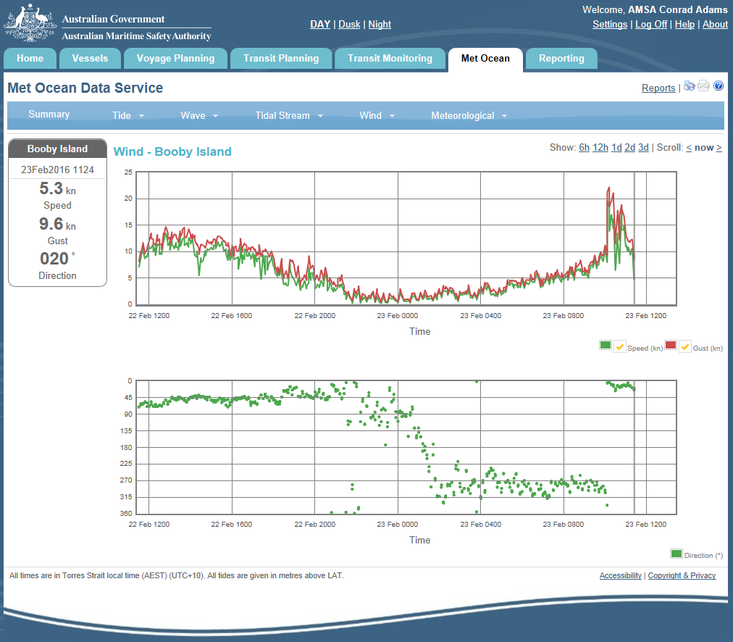
Met Ocean Data – Wind Detail

Slide 32
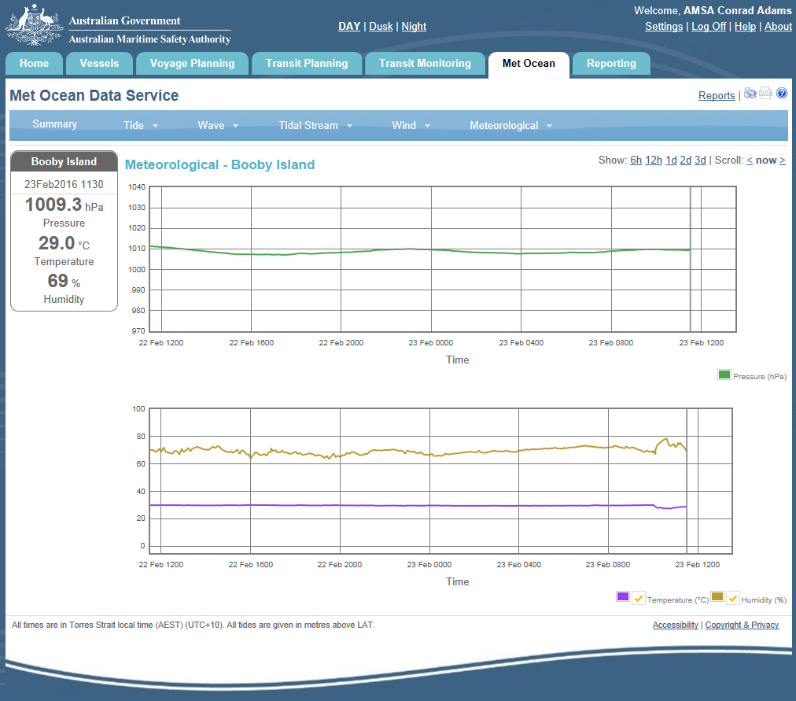
Met Ocean Data – Meteorological Info

Slide 33
Current & Future Arrangements
The UKCM system is comprised of a series of geographic ‘nodes’ (see next slide).
The minimum depth of water in each node is used for the basis of calculating UKC for any planned transit.
The minimum node depth is used as the basis for generating ‘alerts’ which may indicate the minimum UKC requirement has been exceeded (i.e. potential UKC breach).
Whether an actual breach has occurred will depend on where the ship has transited in relation to the minimum node depth.
A ‘chart overlay’ graphic enhancement has been released in 2015.
Day / Night / Dusk illumination modes have also been introduced.

Slide 34
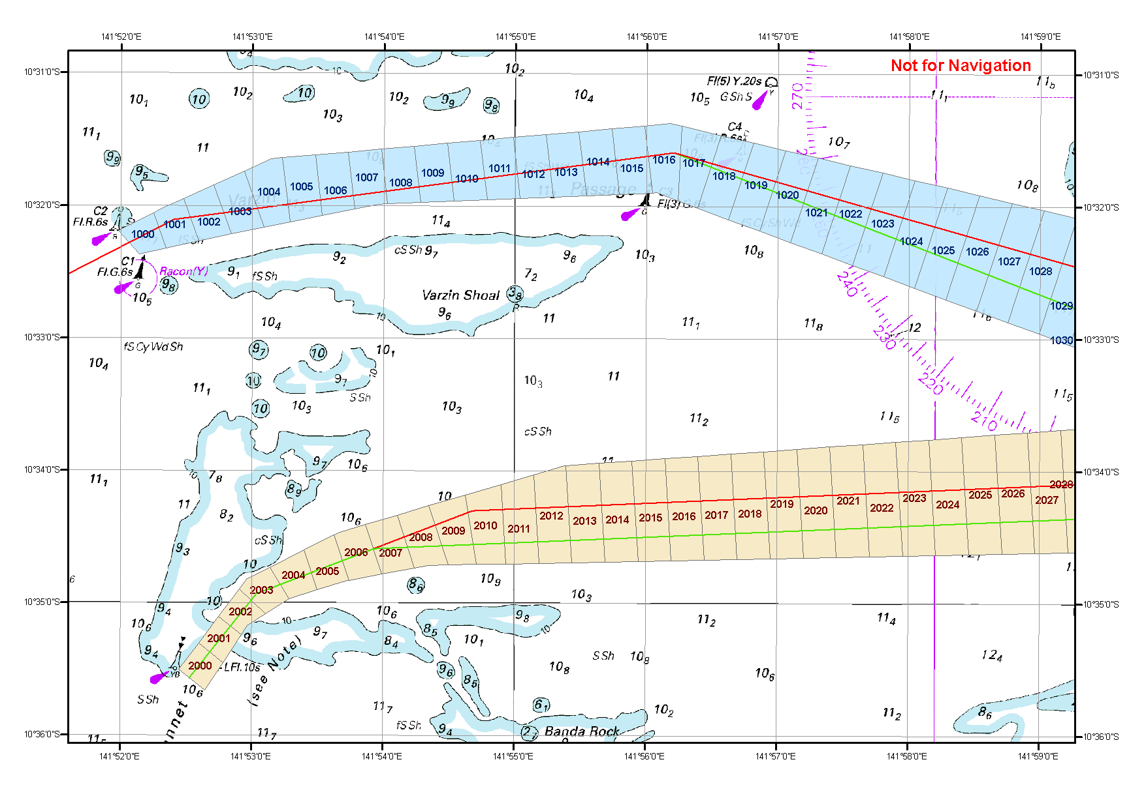
UKCM System Overview - Nodes
Notes:
This slide depicts the Varzin Passage and Gannet Passage entry/exit points within the UKCMS. The routes are divided up into ~500 yard segments or nodes, each with its own identifying number and ‘controlling depth’.

Slide 35
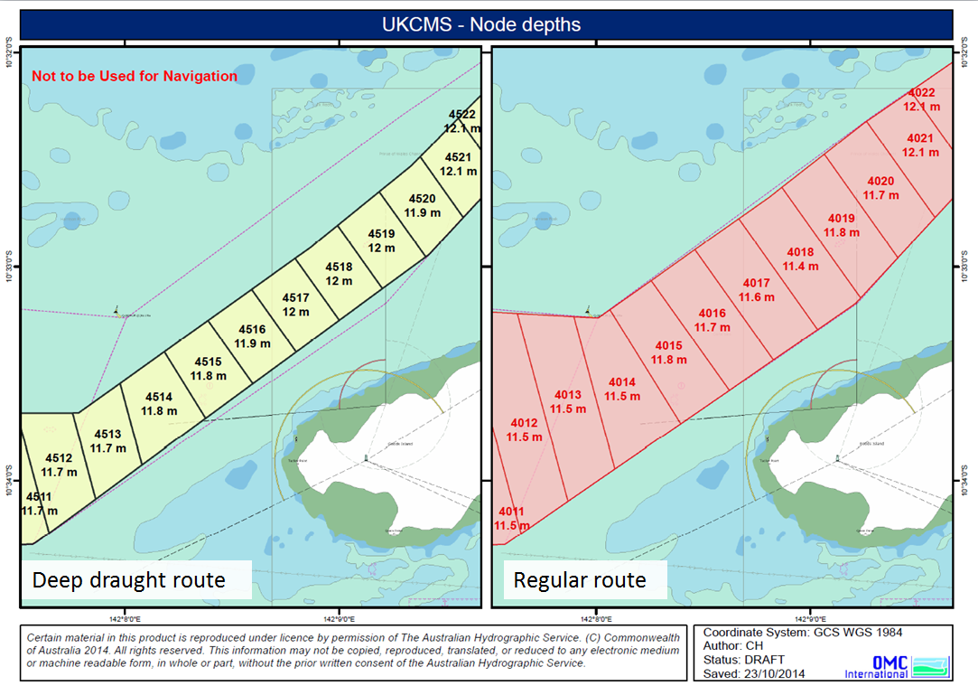
UKCM System Overview – Nodes & Routes
Standard route
Notes:
Within the UKCMS there are standard routes (which use the full channel width) and deep draught routes which provide less channel width, but the greatest available bathymetry within a channel area.
The last two node numbers represent identical sections of the channel in frames 1 and 2 in the presented image, with the narrower, deep draught route (depicted in yellow) showing equal or greater nodal controlling depth than the full width standard route (depicted in pink).

Slide 36
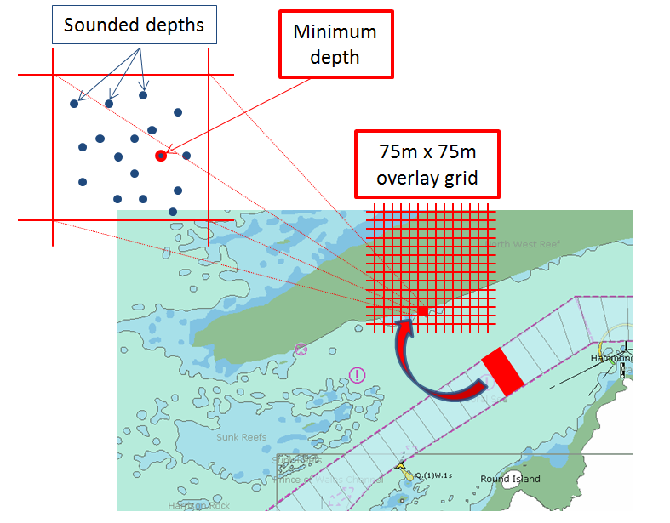
UKCM System Overview - Grid
Notes:
Overlaid on the UKCMS nodal assignments is a more finely tuned 75 m X 75 m grid. This grid is what drives the Chart Overlay feature of the system, providing an indication of “go” and “no go” areas (in terms of UKC that satisfies the AMSA limit.
The exploded view box pictured depicts the various sounding points as recorded by the AHS for the nominated cell, with the minimum sounded depth becoming the ‘cell controlling depth.
Note that within the UKC corridor, a cell controlling depth will never be less than the nodal controlling depth.

Slide 37
Chart Overlay Enhancement
The UKCM system has recently been enhanced to incorporate a new ‘chart overlays’ function which provides a ‘real-time’ graphical representation of available water & ‘go / no-go’ areas across the system’s area of operation (depicted next slide).
This functionality greatly assists pilots to plan routes that follow the deepest water available and therefore increase the extent of transit windows.
Pilot competency in the use of this function is required by AMSA. Access to enhancements is provided post assessment.

Slide 38
UKCM System Nodes
Nodes

Slide 39
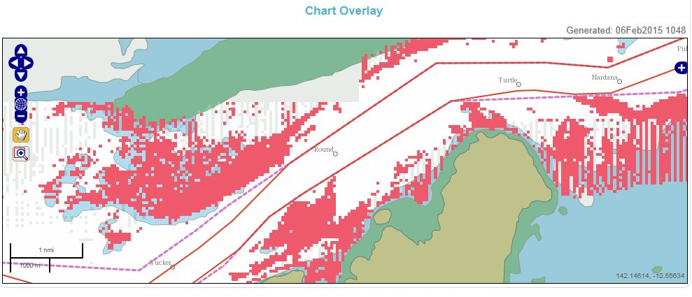
Chart Overlays
Graphic Indication of Go / No-Go Areas
Notes:
For example -

Slide 40
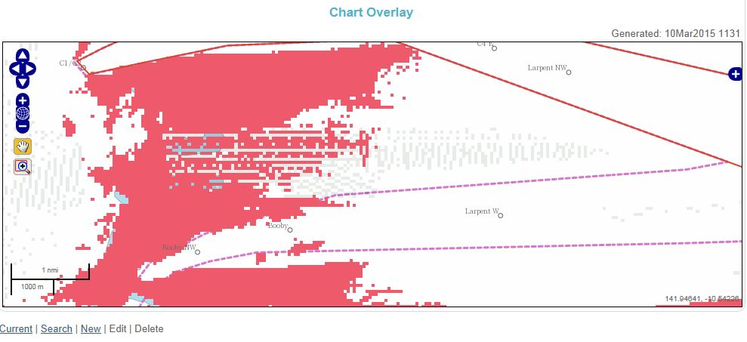
UKCM System - Chart Overlays
Entrance Window Example (No-Go)
Gannet Passage
Notes:
For example -

Slide 41
System Overview - Summary
The AMSA UKCM System has the following characteristics:
Is an AMSA-owned system, hosted and supported under licence by ‘OMC International’, the system developer.
Is a web-based application accessible using everyday internet browsers.
Produces complex proprietary UKC calculations integral to the Voyage and Transit Plans.
Accounts for squat, heel and environmental influences based on vessel’s speed profile and hull design (block coefficient etc.).
Is highly configurable with various user and system settings able to be adjusted if required.
Accurate hydrographic survey data underpins the entire system.
System Overview - Summary

Slide 42
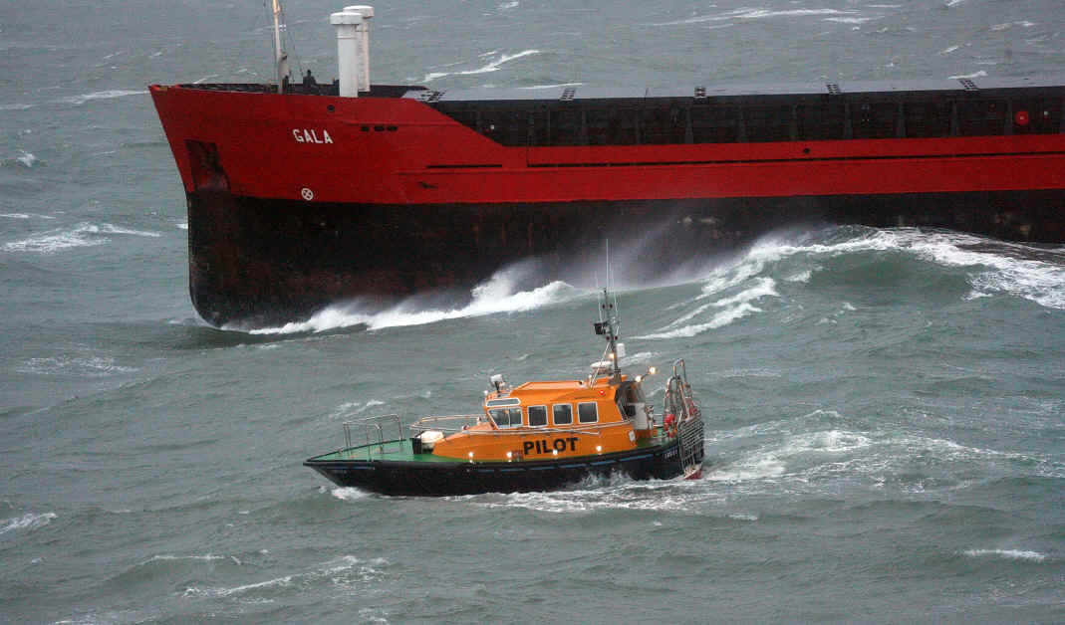
Thank You
For further information on AMSA’s Coastal Pilotage arrangements, please contact:
Conrad Adams
Principal Advisor – Coastal Pilotage
Email:
conrad.adams@amsa.gov.au
Ph: 07 3001 6806
On AMSA’s UKCM System, please contact:
Lindsay Perryman
Advisor - Coastal Pilotage (UKC)
Email: lindsay.perryman@amsa.gov.au
Phone: 07 3001 6831

